Slide 1
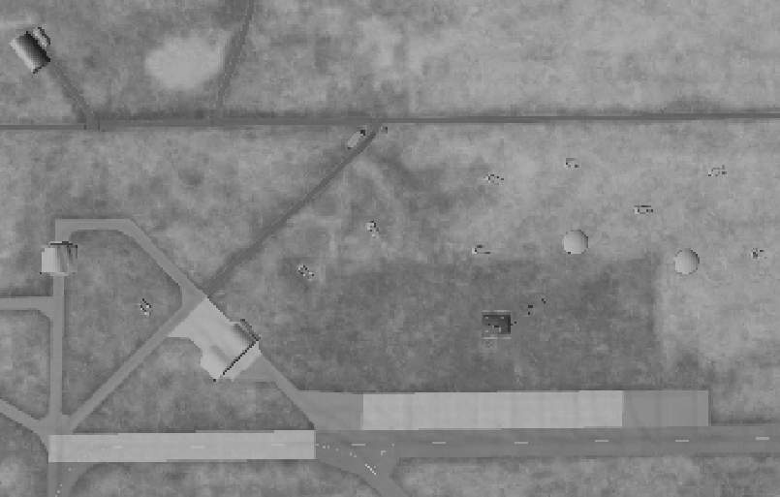
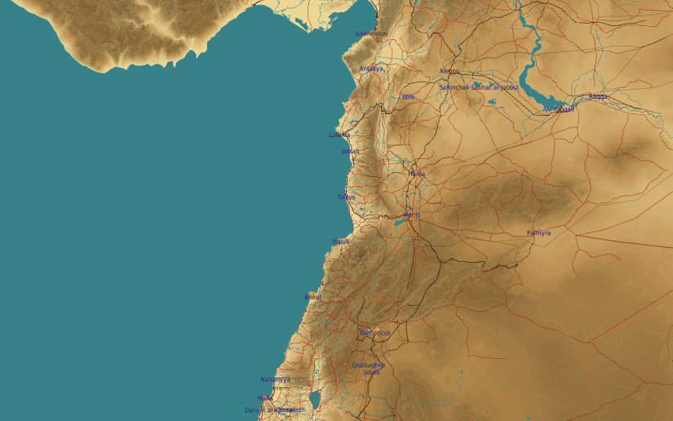
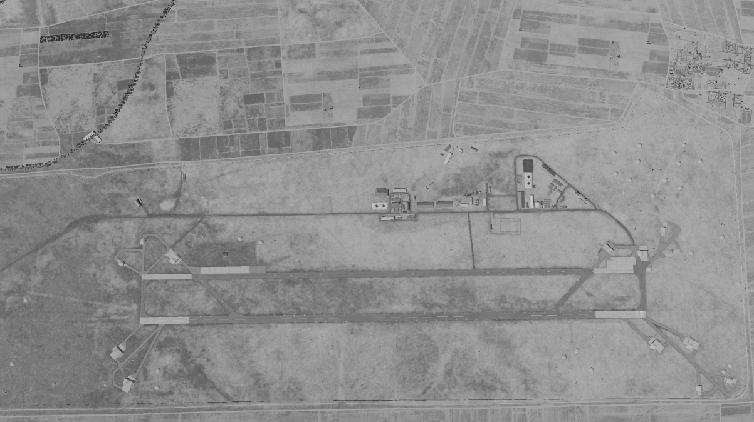
OPARTGT069 Sector Command Centre WEST
069
2
N
DESCRIPTION OF THE DESIRED POINTS OF IMPACT WITH WPN TYPE:
OPARTGT069 DPI 1: Command Bunker, concrete and reinforced steel. DPI is center if the bunker. 1x 2000 Ibs bomb with delayed fuzing is needed to destroy the structure.
DPI 1 – N35 44.175 E037 05.603/ 816ft (TLE CAT 1 Coordinates)
Recommended weapon: GBU-31(V)3/B
DPI1
5
6
SCC WEST is located al Al Duhur Airfield.
7
8

